Slide 1


Indigenous Domestic Violence Survivors’ Wellness Services: Uplifting Our Voices
Kendra Root, NIWRC Research Associate

Slide 2
Needs Assessment Components
Introduction
Background
Framework/Methodology
Analysis
Initial Key Findings
Offerings/Recommendations

Slide 3
Being Trauma Aware
Content & Trigger Warning
This Needs Assessment discussion will contain Domestic Violence Survivor voices of lived experiences within the content. If at anytime you may feel uncomfortable, I encourage self-care and please feel free do what is best for you.
Notes:
From the Key Findings there will be quotes from DV survivors that could possibly be triggering. I want this space of the presentation to be of community and an opening sharing space.

Slide 4
Introduction
Purpose/Goals of the Needs Assessment
Needs Assessment Evaluation Questions
Why is this Needs Assessment important?
Notes:
Introduction: As a culturally resource center we were to develop a needs assessment;
Needs Assessment Evaluation proposing questions – What are the lived experiences of Native American women who are survivors of DV/IPV ; Goals of what the Needs Assessment was trying to accomplished;
What are the holistic wellness journeys from Native American women who are domestic violence survivors?
Survivors' stories captured the needs for physical, mental, emotional, and spiritual restoration of balance in their lives.

Slide 5

Background

Slide 6
Background
What are the current Domestic Violence issues with Healthcare and Service Providers in Indian Country?
Literature Foundations
Scope and Complexities
Notes:
Provide points from 5 academic literature review references to understand what current literature states regarding the issues around DV/IPV and experiences with Healthcare Providers and DV Service Providers.
We know of the issues:
-Cultural responsiveness (cultural appropriateness - within DV service providers)
-DV service providers need training on being trauma informed (questions as of DV survivors)
-Providers Care: lots of information in literature around Providers also taking care of themselves. (when one can not take care of themselves how can they take care of others, and community members)
Theses are the complexities that are very current within our communities.
Identifying any issues other issues within other communities?

Slide 7
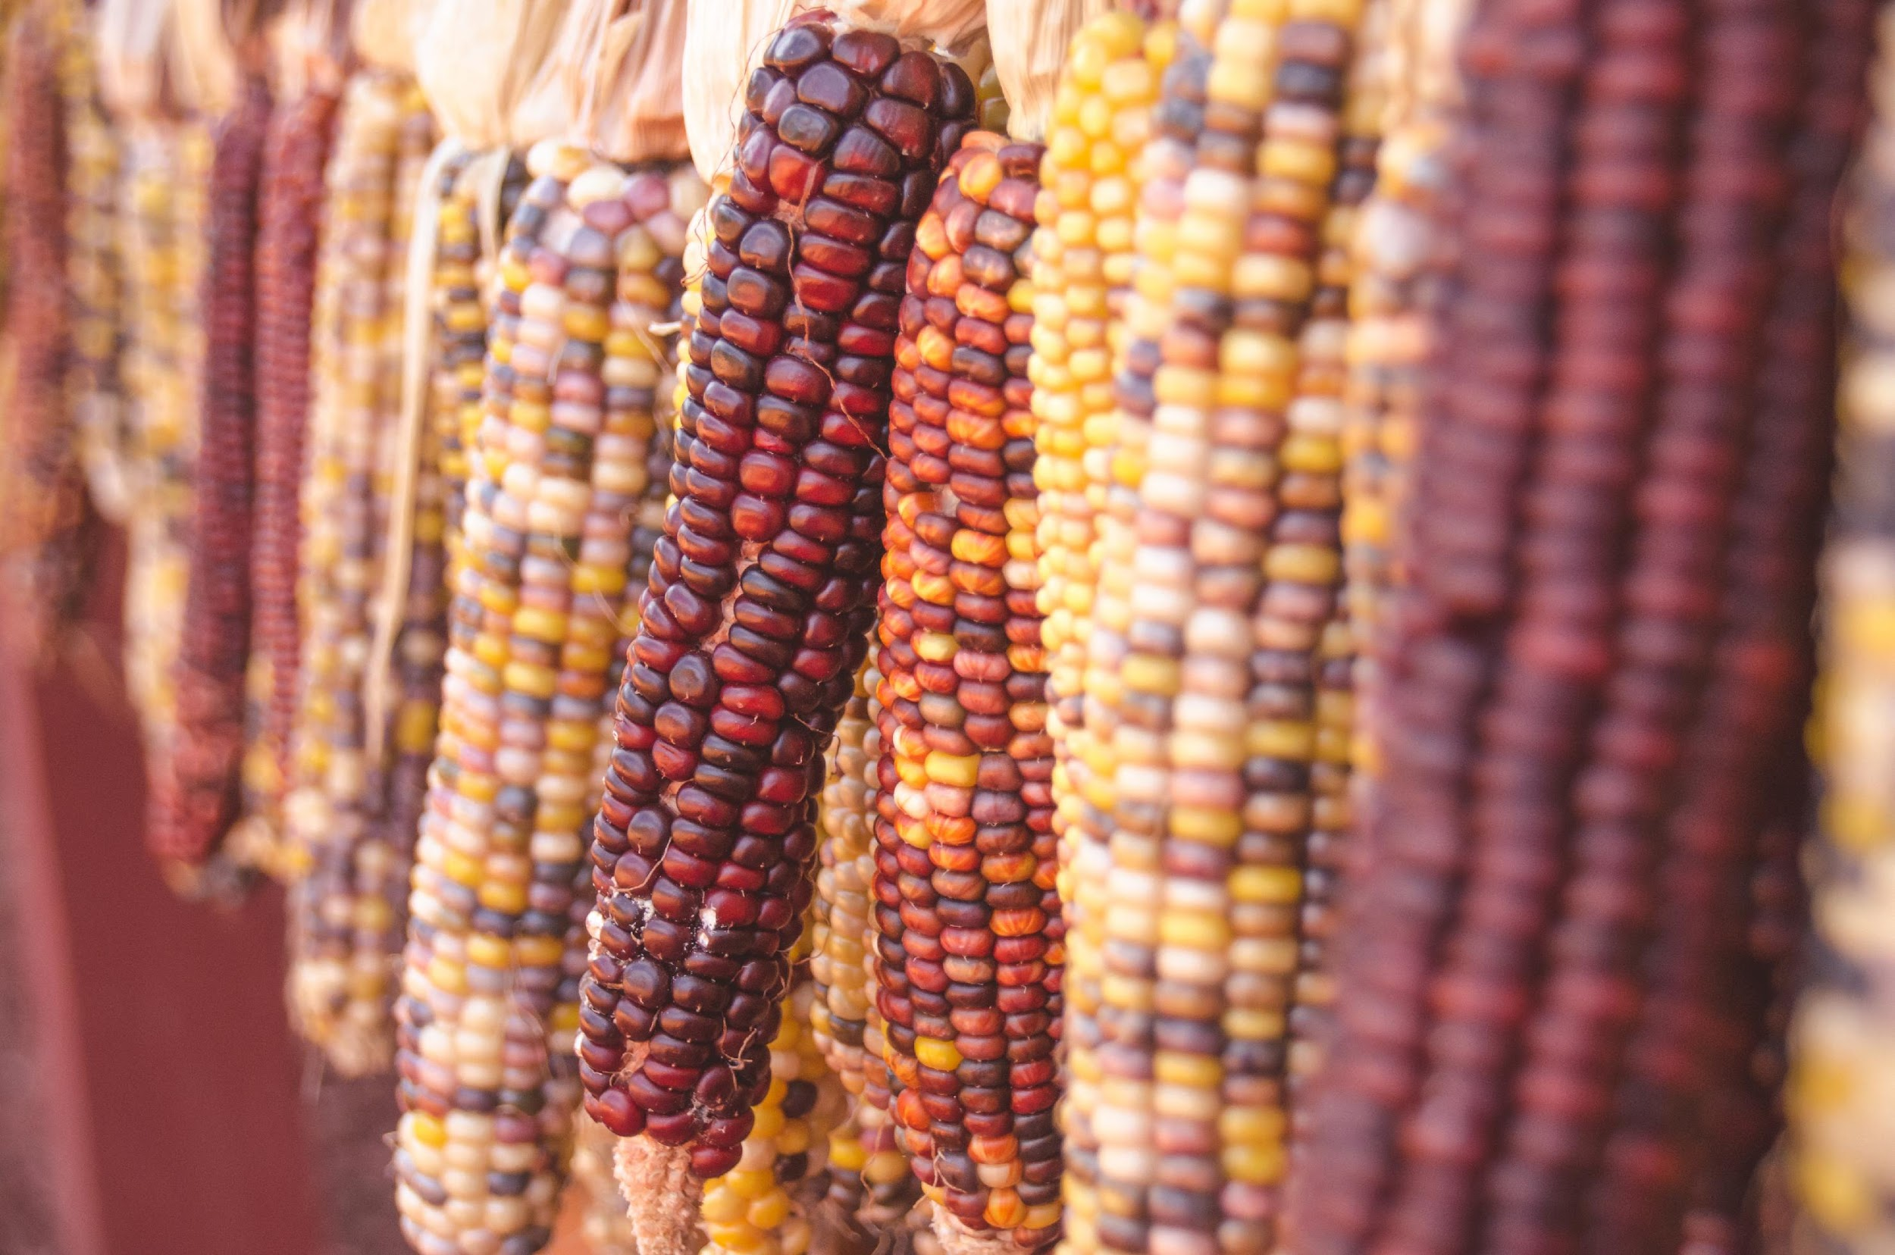
Framework/Methodology

Slide 8
Framework/
Methodology
What was the process of data collection?
Framework
Recruitment Plan
Criteria
Diversity of Survivors
2 Focus Groups
Norms for Community Sharing
Notes:
Feminist/Decolonizing theory was used throughout the needs assessment concepts of thought and design;
how we recruited survivors use social media for recruiting of interest- recruiting form to fill out - within personal identifiers
criteria the survivors met to be invited to participate in the focus group; Native American women DV/IPV survivors or in a current abusive relationship
what the focus group generally looked like (region, sexuality, age); Mean age was about 42
what the norms were established within the focus groups for survivors' participation - over zoom is very hard to conduct focus groups: gave space for all to interact - left their camera on, use the raise hand feature however also wanted the space to feel comfortable.

Slide 9

Analysis

Slide 10
Analysis
Analyzing/Coding
Researcher as an Instrument
Notes:
Opening Coding, how coding was utilized and used to help in the formation of analyzing
researcher as an instrument. How I as a researcher was used in the develop key findings: Author Patton provides literature regarding how to a Research is used as an instrument. Within opening coding a Researcher thus is used as an analysising instrument.

Slide 11

Initial Key Findings

Slide 12
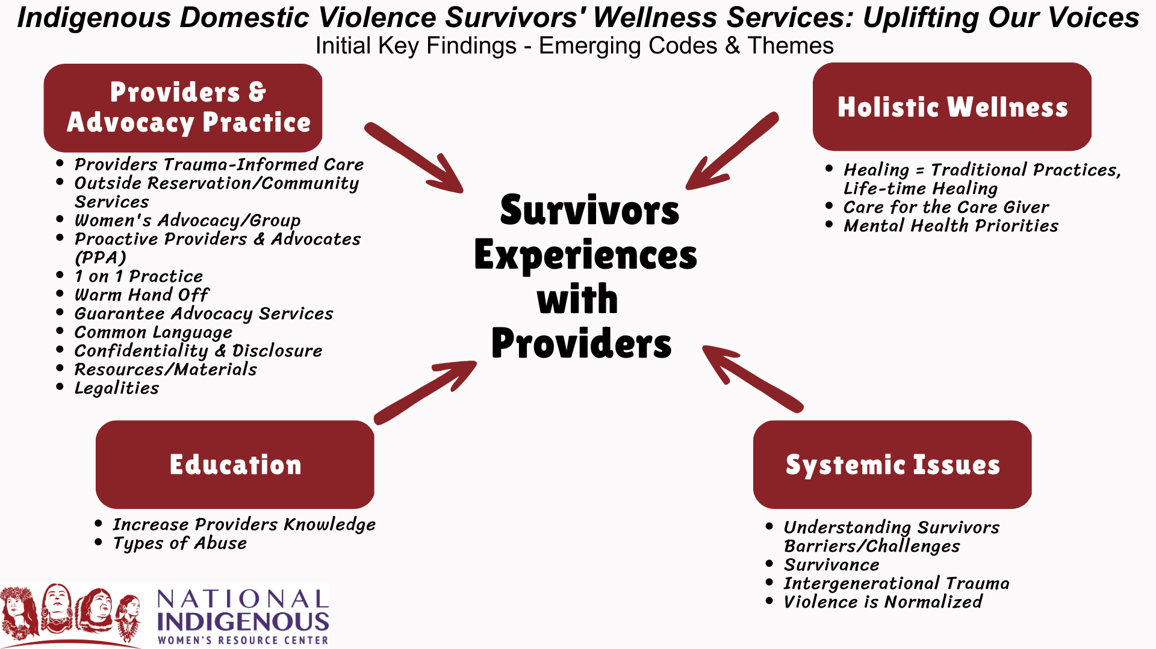
Initial Key Findings
Notes:
Discussion of Codes/Themes and providing survivors quotes from each. In thinking through the codes/themes how each reflects within offerings/recommendations for the DV Healthcare and Service Providers communities.

Slide 13

Offerings/Recommendations

Slide 14
Offerings/Recommendations
Offerings from Survivor experiences as Recommendations from Themes
  Providers & Advocacy Practice
  Education
  Holistic Wellness
  Systemic Issues
Notes:
Continuing emerging themes for recommendations for practitioner changes include providing adequate resources and materials to encourage wellness and healing, culturally specific, and diversity training.

Slide 15
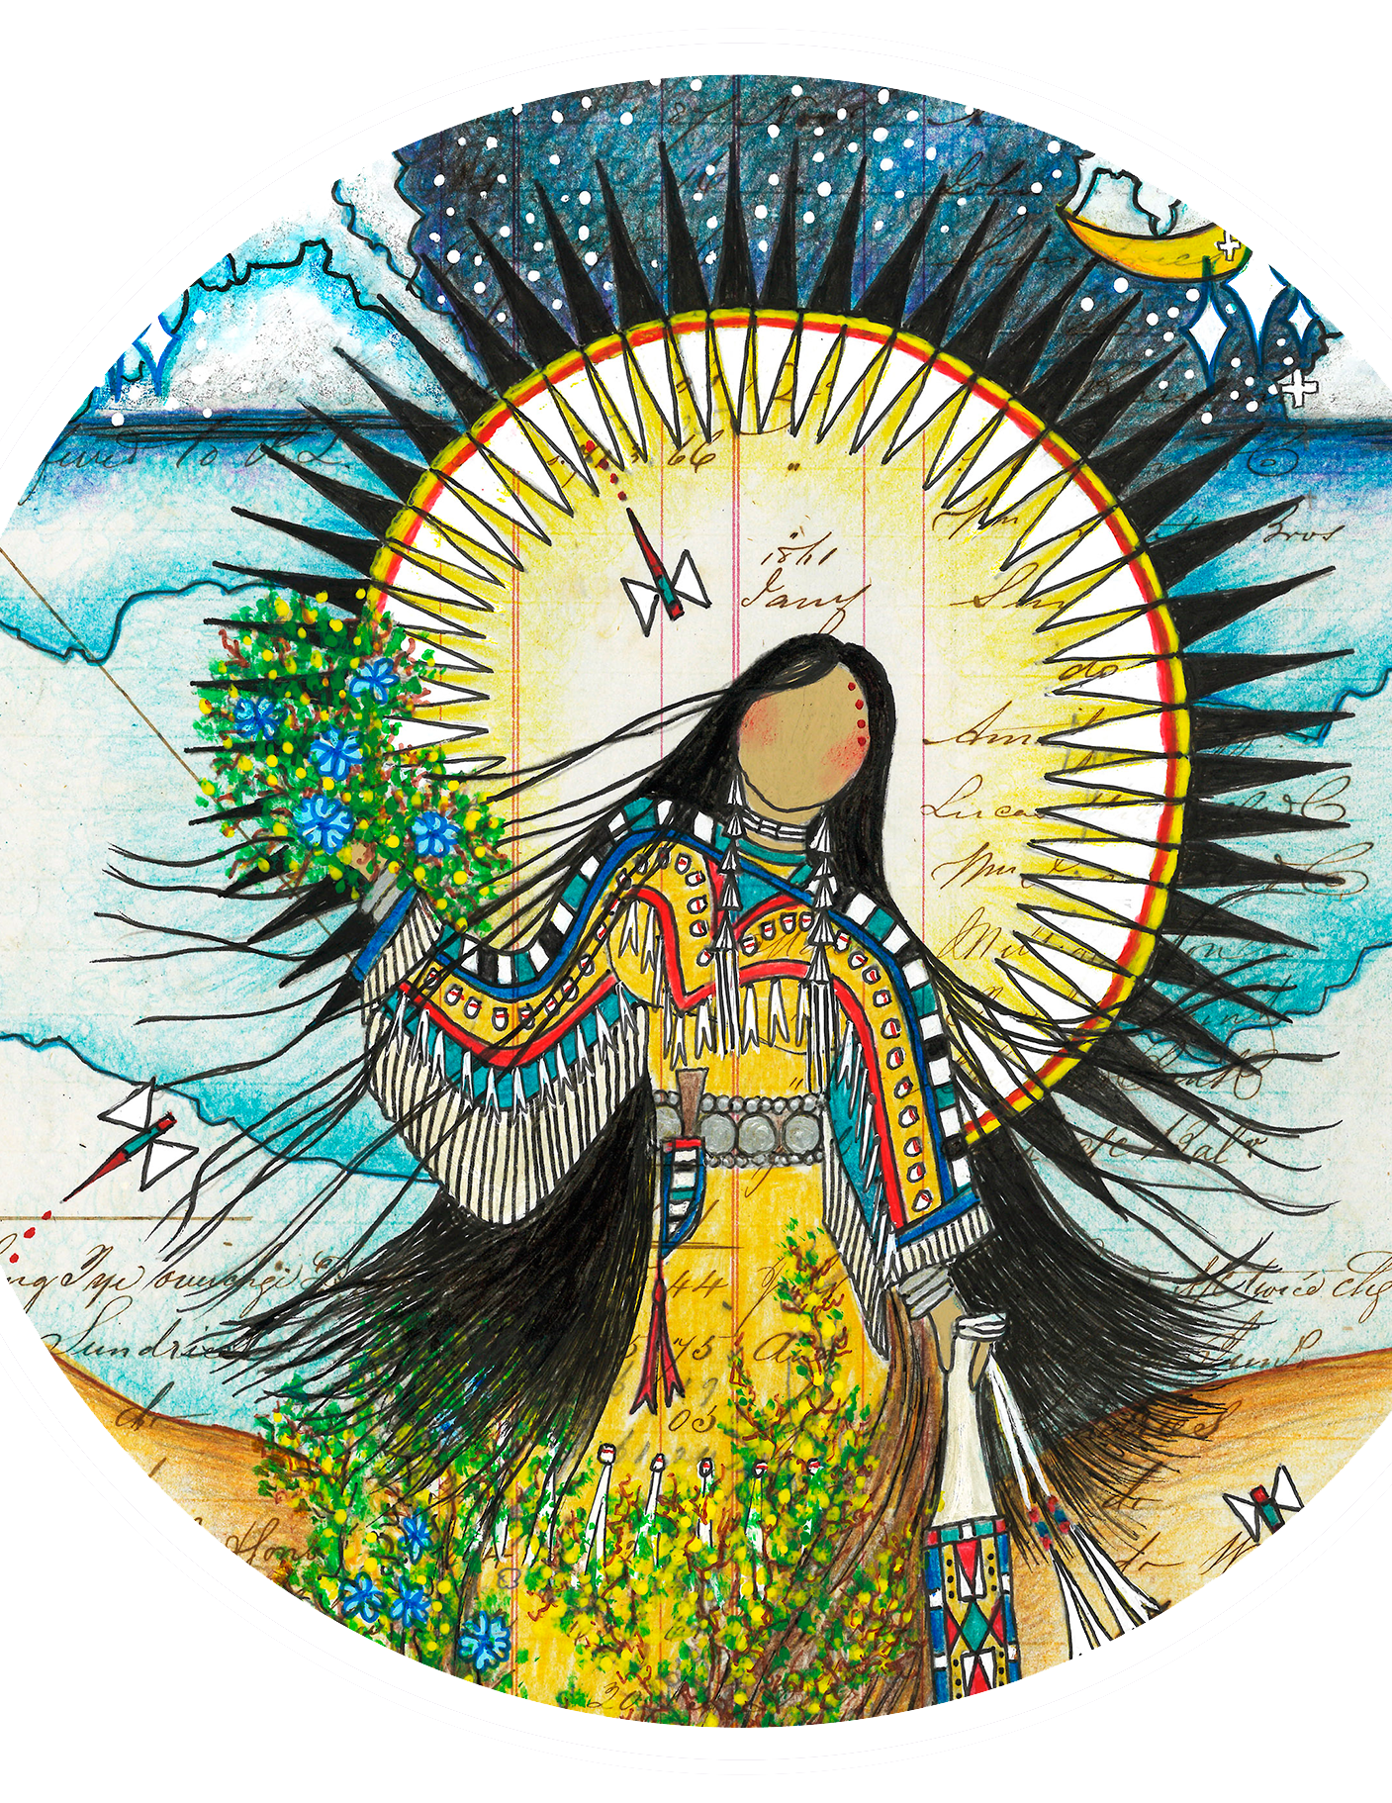


MVTO!
Thank You!
Kendra Root, Muscogee Nation
Kroot@niwrc.org
This presentation was made possible by Grant Number 90EV0452-01-00 from the Administration of Children, Youth and Families, Family and Youth Services Bureau, U.S. Department of Health and Human Services. Its contents are solely the responsibility of the authors and do not necessarily represent the official views of the U.S. Department of Health and Human Services.

